Slide 1
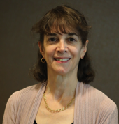
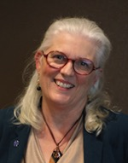

PFCC Partnerships in Long-Term and Continuing Care Community Settings for the Elderly During COVID-19
November 12, 2020
Marie Abraham, MA
Vice President, Programming
and Publications
Mary Minniti, CPHQ
Senior Policy and Program Specialist
Natasha Reed
Registration and Database Manager

Slide 2
General Tips
All participants will be muted upon entering
Please use the chat box for all questions and comments
A recording of this presentation and all handouts will be available on www.ipfcc.org
If you come across any technical difficulties, please call or text Natasha Reed at 646-789-1613

Slide 3
Objectives
Discuss short- and long-term impacts of COVID-19 related changes on the health of elderly residents in continuing care communities and their families;
Learn about strategies implemented across care settings serving elderly residents to address COVID-19 challenges; and
Explore innovative approaches used to mitigate negative impacts, reduce isolation, and restore partnerships even as the pandemic continues.

Slide 4

Supporting PFCC Practices and Strategies in the Time of COVID-19
Goal: Provide a resource and “clearinghouse” for up-to-date, easily accessible, information about ways to stay grounded in PFCC core concepts during COVID-19
  IPFCC will identify, develop, and disseminate information related to COVID-19 across adult health care settings.
  Target audience: Adult healthcare settings across the continuum including hospitals, ambulatory and primary care settings as well as continuing care/retirement communities
The series of free webinars and online conversations will occur monthly from July through March 2021.
Funded by a grant from

Slide 5

Patient- and Family-Centered Care — True North
In a pandemic, the core concepts of patient- and family-centered care (PFCC)
can serve as a North Star,
to help inform decision-making, practices, and public health strategies.

Slide 6
PFCC Core Concepts
People are treated with dignity and respect.
Health care providers communicate and share complete
and unbiased information with patients and families in
ways that are affirming and useful.
Patients and families are encouraged and supported in participating in care, care planning, and decision-making at the level they choose.
Collaboration among patients, families, and providers occurs in policy and program development, QI and safety, professional education, and research as well as in the delivery of care.

Slide 7
COVID-19 Impact on Elder-Care Homes
Outbreaks and deaths related to COVID-19 more prevalent in group care settings of those 60 years and above
Severe lockdowns occurred quickly, preventing residents from access to family, other loved ones, and the community
In the U.S. more than 87,000 residents and workers have died of the virus; 500,000 people tied to facilities have been infected with COVID
Pandemic shows no sign of abating and in some places is increasing exponentially

Slide 8
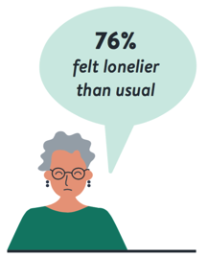
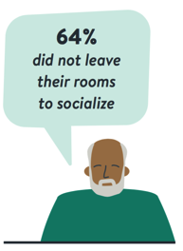
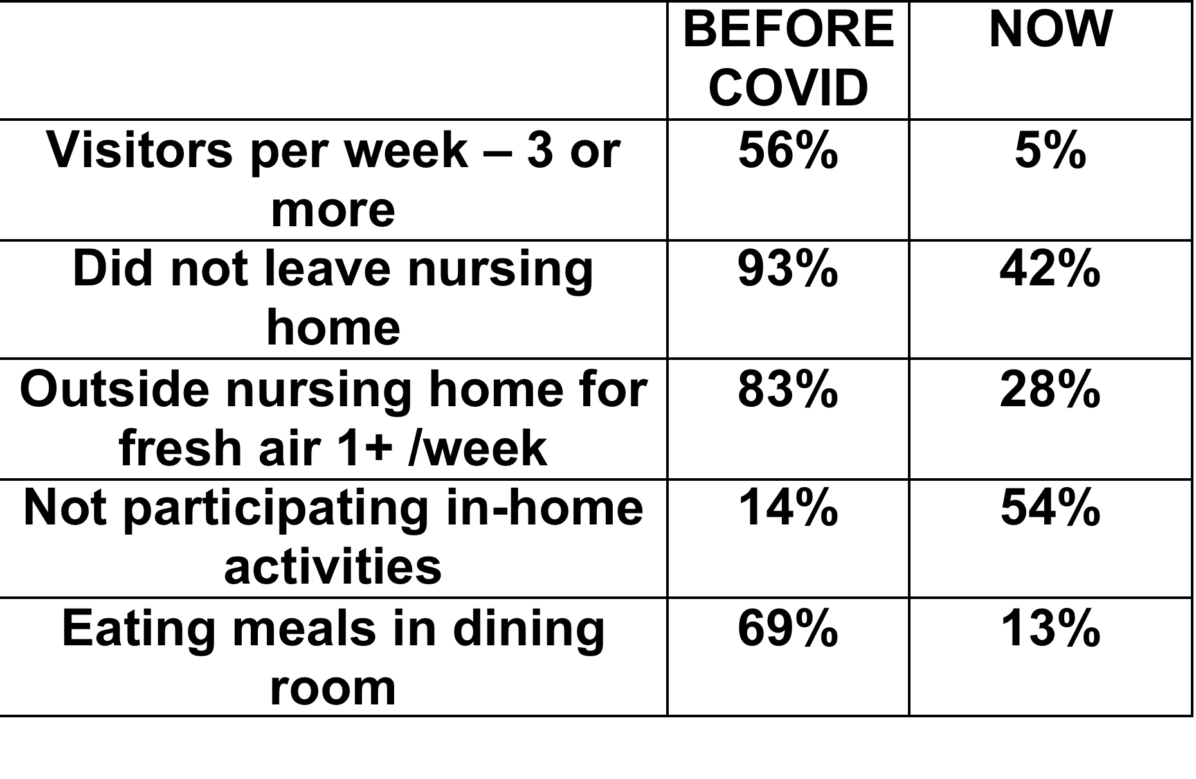
Experiences of Nursing Home Residents
During the Pandemic – Online Survey
Social interactions outside and within the nursing home have dropped sharply!
https://altarum.org/publications/experiences-nursing-home-residents-during-covid-19-pandemic?utm_source=Improving%20Eldercare%20Newsletter&utm_campaign=1b2d8c32b1-EMAIL_CAMPAIGN_PIE_Nursing-Home-Survey-Result&utm_medium=email&utm_term=0_1cf25d09c2-1b2d8c32b1-355008361

Slide 9
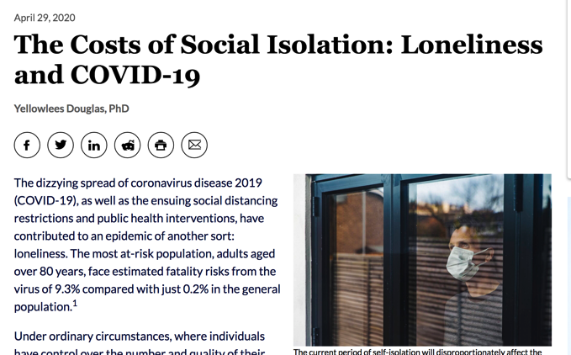
Elevated blood pressure, morning spikes in cortisol levels, and disrupted sleep
Significant declines in cognitive performance and increases in cognitive impairments
28% of adults who had been quarantined displayed sufficiently severe symptoms of PTSD to warrant a diagnosis of a trauma-related mental health disorder

Slide 10
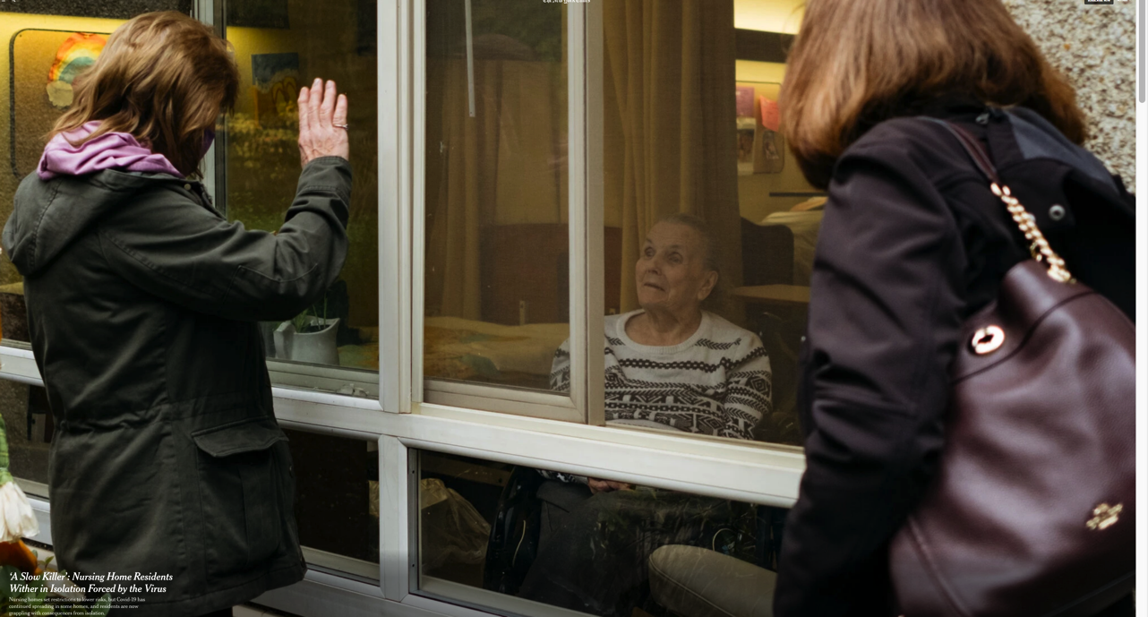

Slide 11
"They are among thousands of older people stricken by another epidemic ravaging America’s nursing homes — an outbreak of loneliness, depression and atrophy fueled by the very lockdowns that were imposed to protect them from the coronavirus."
Healy, et. al. A Slow Killer: Nursing Home Residents Wither in Isolation Forced by the Virus
https://www.nytimes.com/2020/10/30/us/nursing-homes-isolation-virus.html?referringSource=articleShare

Slide 12
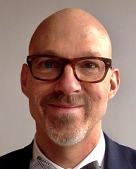
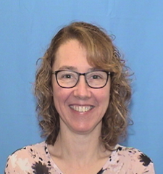

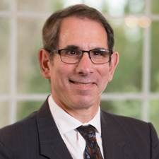
Meet the Panelists
Richard J. Mollot
Executive Director
The Long Term Care
Community Coalition
Eva Chmielewski, RN BSN
Staff Education Coordinator
Martha T. Berry Skilled
Nursing Facility
Reverend Dr. Derrick C. Dewitt, Sr.
Director/Chief Finance Officer
The Maryland Aged Home
Rob Schreiber, MD, AGSF
Vice President and Medical Director
Summit ElderCare

Slide 13
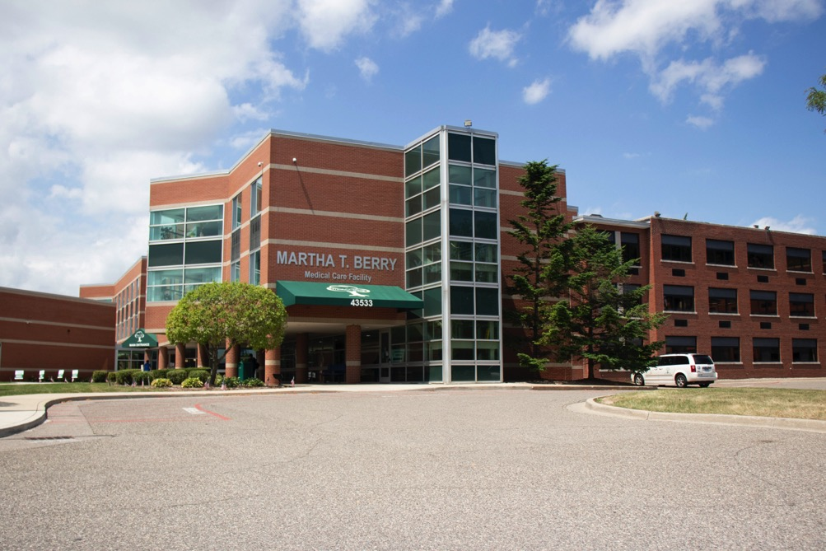
Martha T. Berry Medical Care Facility in Mt Clemens, MI

Slide 14
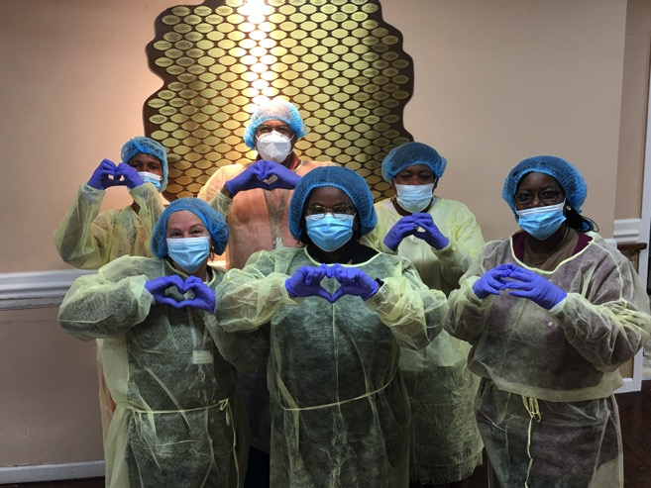
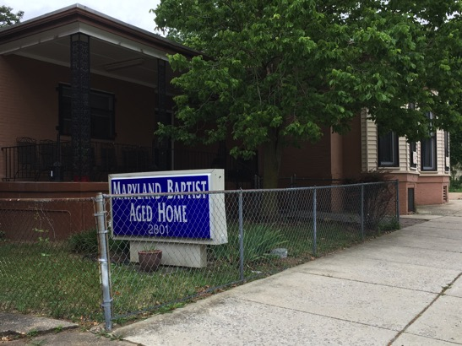
The Maryland Aged Home in Baltimore, MD

Slide 15
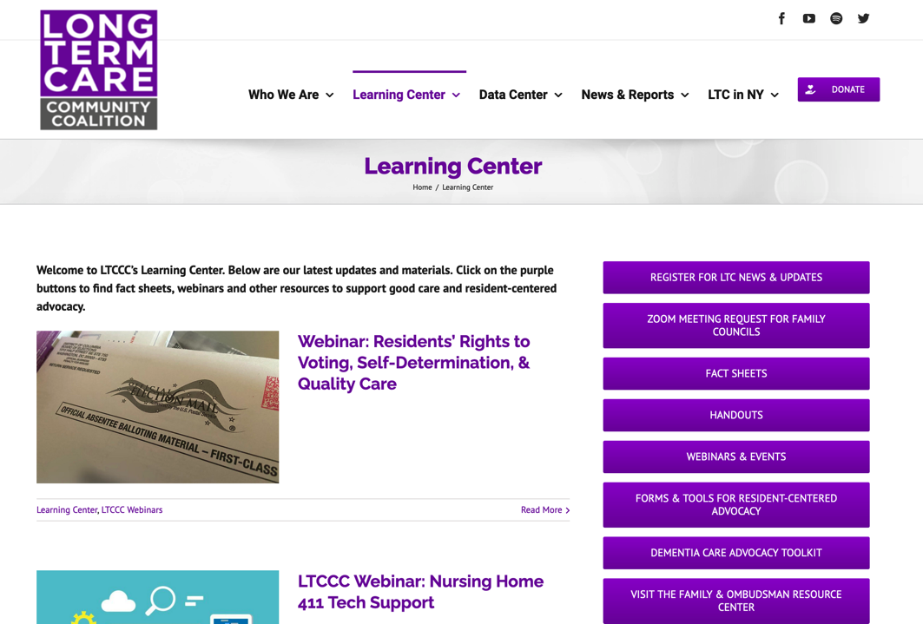

Slide 16
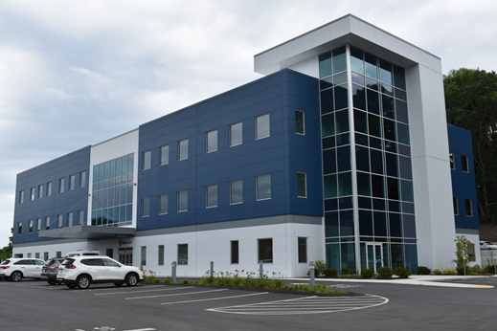
Summit ElderCare Facility in Worcester Massachusetts.

Slide 17

Please chat in any questions for the panelists

Slide 18
Recommendations for Long Term Care
Prioritize person-centered care, which is care that meets residents’ physical, emotional, and psychosocial needs and gives them choices and control over their daily lives.
Balance strict measures designed to limit the spread of the virus with the need to support the physical, emotional, and psychosocial needs
Designate essential caregivers who would have increased access to LTC facilities to fill a defined role for specific residents.
Ensure family members can obtain accurate and timely information on residents’ health and well-being.
Provide counseling to LTC residents on their options to receive
services in the community and support those who want return to the community
https://www.mathematica.org/our-publications-and-findings/publications/fr-a-study-of-the-covid-19-outbreak-and-response-in-connecticut-long-term-care-facilities

Slide 19
Promising Practices and Recommendations - Community
Foster trusted relationships with vulnerable older patients to identify and address their clinical and non-clinical needs in a timely fashion
Rapid implementation of a comprehensive virtual care approach to facilitate frequent touchpoints between the patient and the care team
Delivery of home-based health-care services to ensure health-care access during the pandemic.
Protecting Vulnerable Older Patients During the Pandemic
Umar Ikram, MD, MPH, PhD, Susanna Gallani, MBA, PhD, Jose F. Figueroa, MD, MPH, Thomas W. Feeley, MD
Vol. No. | September 17, 2020

Slide 20
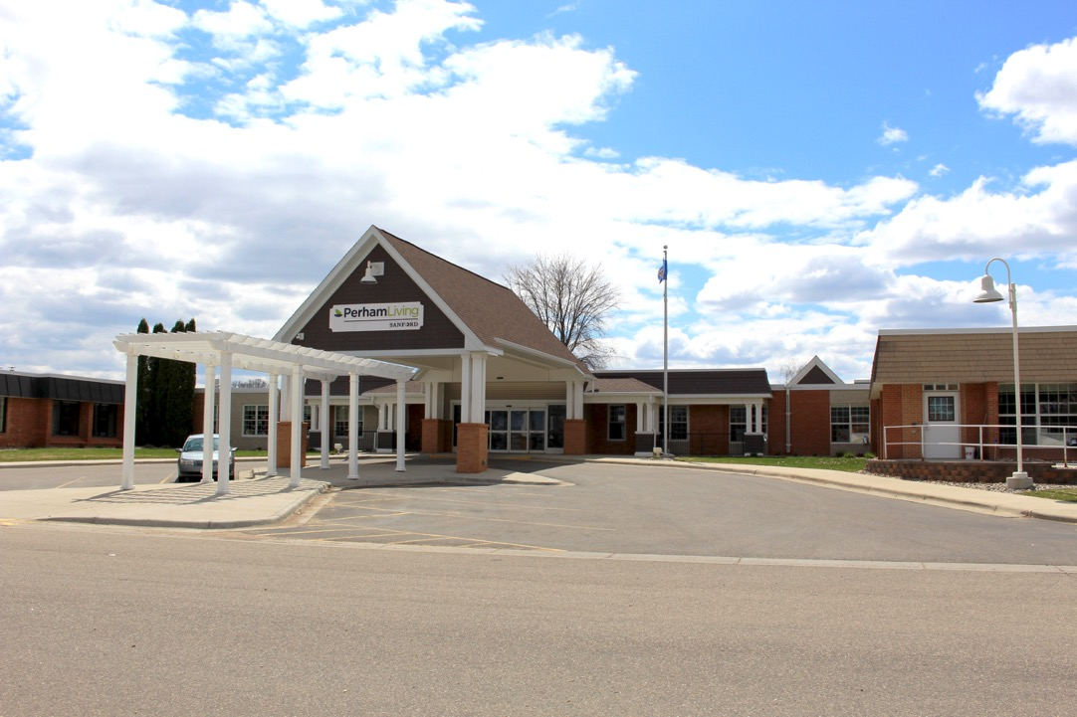
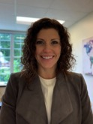
“As a leader, hearing the voices of the residents and families has been instrumental in all of our decision-making. Despite continually changing circumstances, we stay focused on what matters to our residents and families. Balancing patient choice with safety helps us ensure we keep our focus on the resident’s quality of life.”
Tracy Hendrickx
Vice President of Long Term Care
Tracy.Hendrickx@SanfordHealth.org

Slide 21
Committed to Partnership: Perham Living
Strong relationships/partnerships built on PFCC for over a decade
    Overall Resident Council, Household Resident Councils “This is what the guidance is, help us understand what is important . What are your preferences?”
    Family Council (Monthly Zoom Meetings) “How can we implement? What concerns do you have?”
Managers communicate by phone with families about changes
Over 150 Essential Caregivers (90 residents) identified, trained family to attend to resident on daily basis, provided PPE as needed, received same screening as staff…they will now help prioritize when surge requires more strict restrictions

Slide 22
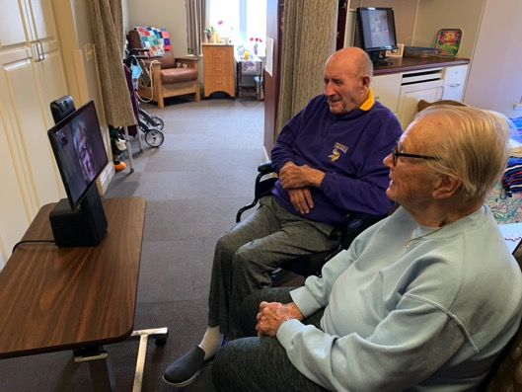
Committed to Partnership: Perham Living
Worked with residents and families to individually apply regulations based on their needs
  Utilized iPads and Facebook Portal for virtual connections
Encouraged and supported compassionate visits; No one dies alone; 2 family members present.
Surveyed all residents and families as regulations permitted re-opening with plans to relocate residents based on risk tolerance

Slide 23
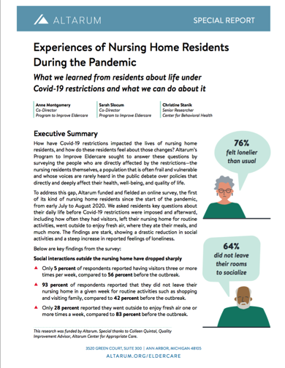

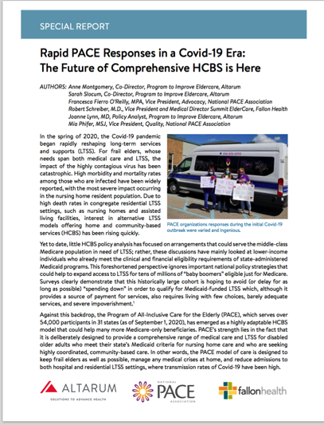
Resources

Slide 24
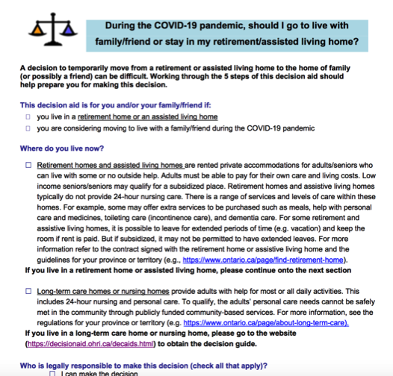

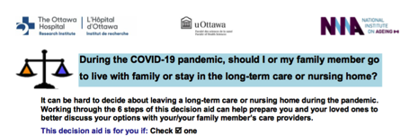
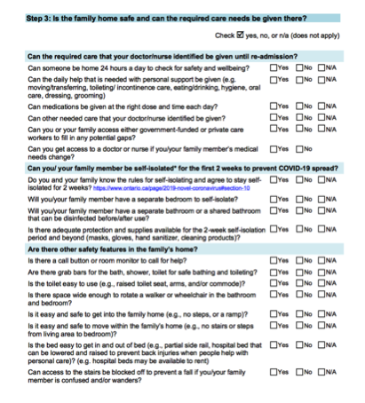
Resources

Slide 25


Resources for Residents and Families
https://theconsumervoice.org/issues/other-issues-and-resources/covid-19/residents-families
https://theconsumervoice.org/issues/other-issues-and-resources/visitation
https://theconsumervoice.org/events/2020-residents-rights-month/staying-connected

Slide 26
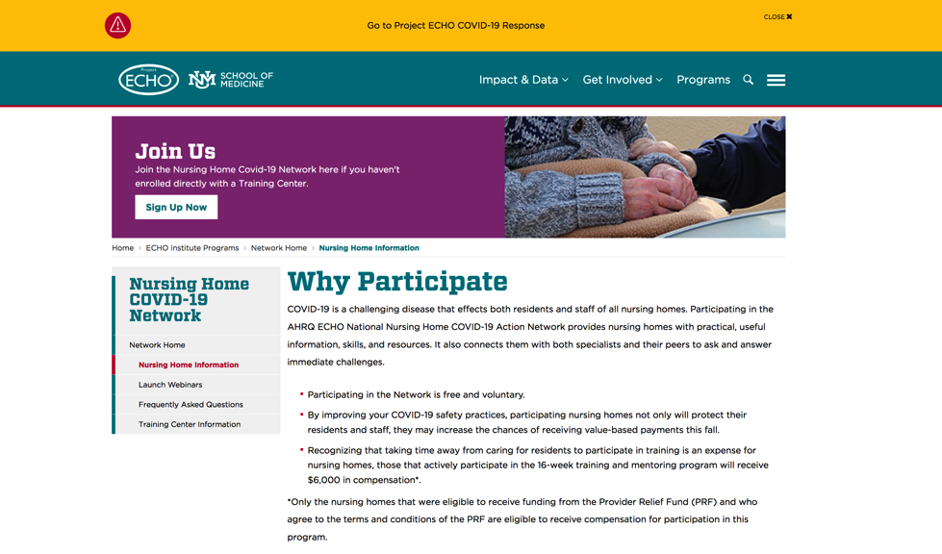
Learning Network: 16 week training/ $6,000 benefit https://hsc.unm.edu/echo/institute-programs/nursing-home/pages/nursing-home-info.html

Slide 27
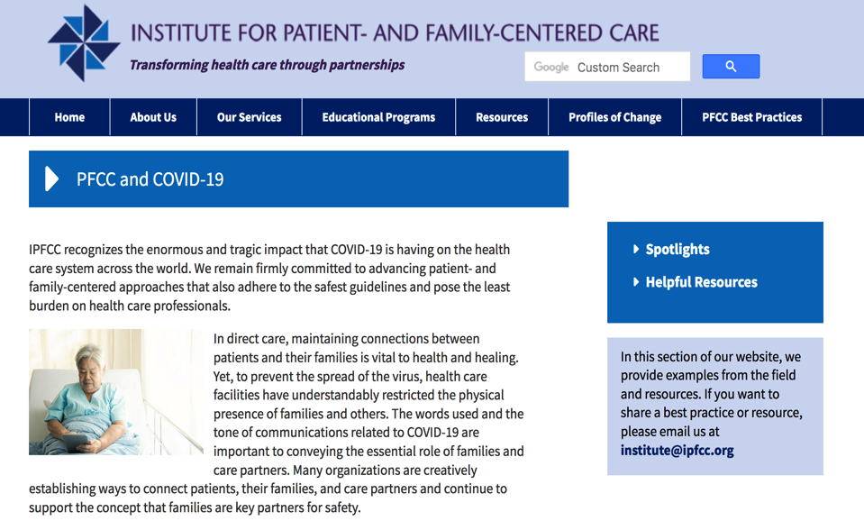
https://www.ipfcc.org/bestpractices/covid-19/index.html

Slide 28
Supporting PFCC Practices and Strategies in the Time of COVID-19
Upcoming Informal Conversations
  Tuesday, December 15th, noon ET
  Tuesday, January 12^{th,} noon ET
  Tuesday, February 9th, noon ET
Upcoming Webinars
  Thursday, January 21st, noon ET
  Thursday, March 11th, noon ET

Slide 29
Thank You for Joining Us!
Please fill out the survey on your experience today:
https://www.surveymonkey.com/r/LTC_Webinar_Nov20
Mary Minniti, CPHQ
mminniti@ipfcc.org

