Slide 1
Notes:
This PowerPoint has been developed to be used by Chief Nursing Officers or other seniors leaders to communicate the need to eliminate restrictive visiting policies to the Executive Team and/or the Board of Directors.*
The Institute for Patient- and Family-Centered Care (IPFCC) is launching the Better Together: Partnering with Families campaign on June 24, 2014, calling on all hospitals to welcome families 24 hours a day and to transform their approach to care so that patients’ families and loved ones are included in care and decision-making, according to patient preferences.
Unfortunately in a 2014 survey, only 58% of US hospitals report that they have a policy or guidelines that permit families or other care partners unrestricted access to the patient, according to patient preference.
IPFCC has recognized 12 hospitals in North America that exemplify success in eliminating restrictive visiting policies and are changing the concept of families as “visitors.” Leaders at these hospitals can attest to the benefits of these changes through improved health outcomes as well as increased patient and staff satisfaction.
. . . I want our hospital to be among the exemplar hospitals.
*NOTE: Suggestions to the presenter are in italics… suggested language to use in speaking is NOT in italics.

Slide 2
A Call to Action
Our hospital must take action now to change the concept of families as “visitors.”
Notes:
Today, I want to discuss a Call to Action to change the concept of families as “visitors” in our hospital. This is the right thing to do from a values perspective, but I think you will also see that it is a smart business decision as well.

Slide 3
Labeling families as “visitors” and imposing visiting restrictions undermines the ability of patients and families to engage in care planning and decision-making and limits their ability to be adequately prepared for the transitions to home and community care.
Notes:
Our hospital labels families as “visitors” . . . This is not the role that families typically play in their loved ones lives. Many of them are the primary caregivers. Families often have knowledge, experience, and expertise that staff and clinicians need to safely care for patients.
Labeling families as “visitors” and imposing visiting restrictions undermines the ability of patients and families to engage in care planning and decision-making AND limits their ability to be adequately prepared for the transitions to home and community care.

Slide 4
There is NO evidence that suggests labeling families as “visitors” and enforcing restrictive visiting policies is the right thing to do.
Notes:
Emphasize the message on this slide . . .

Slide 5
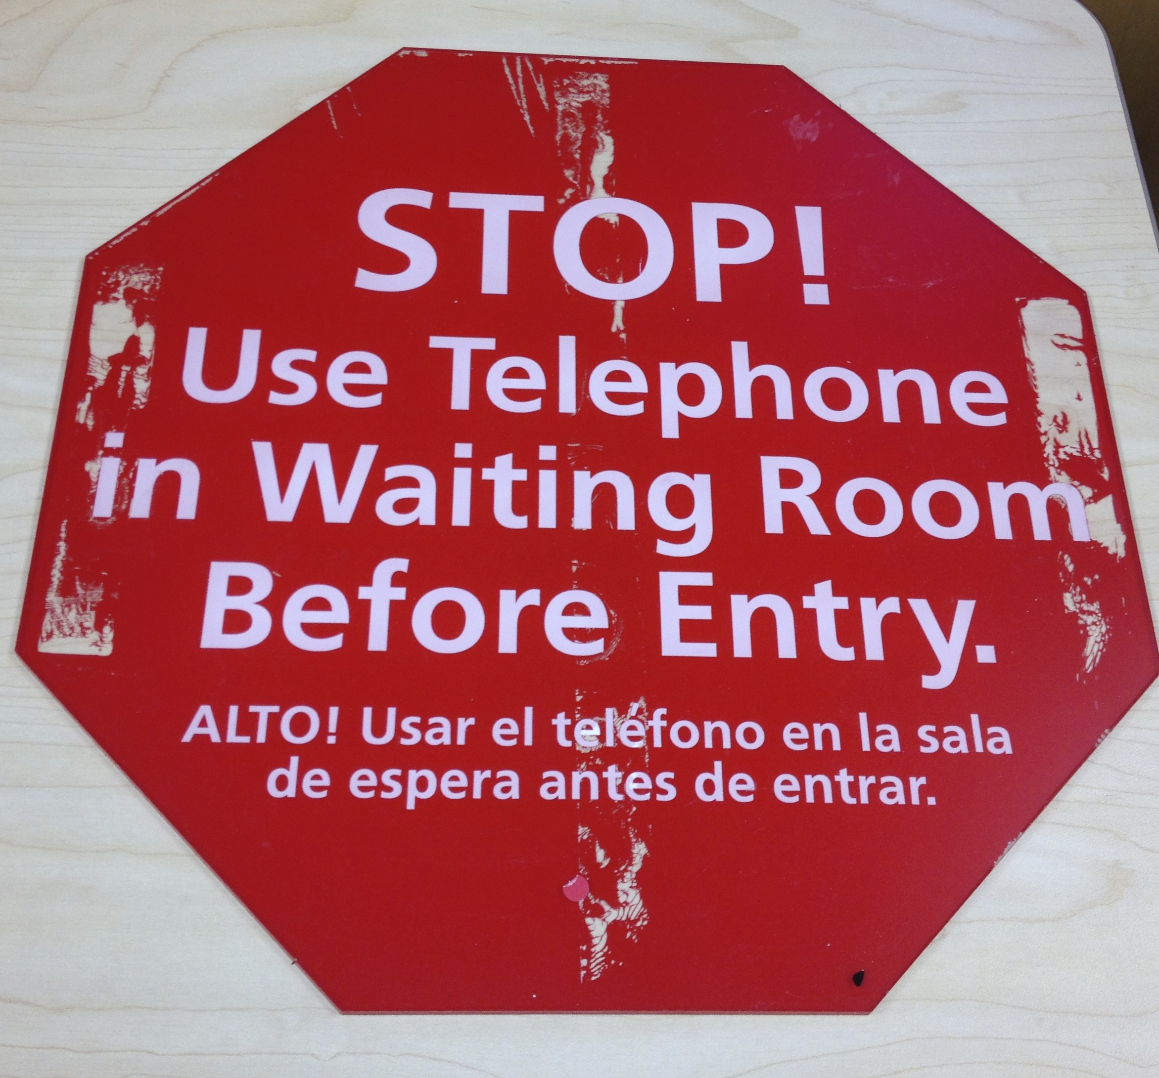
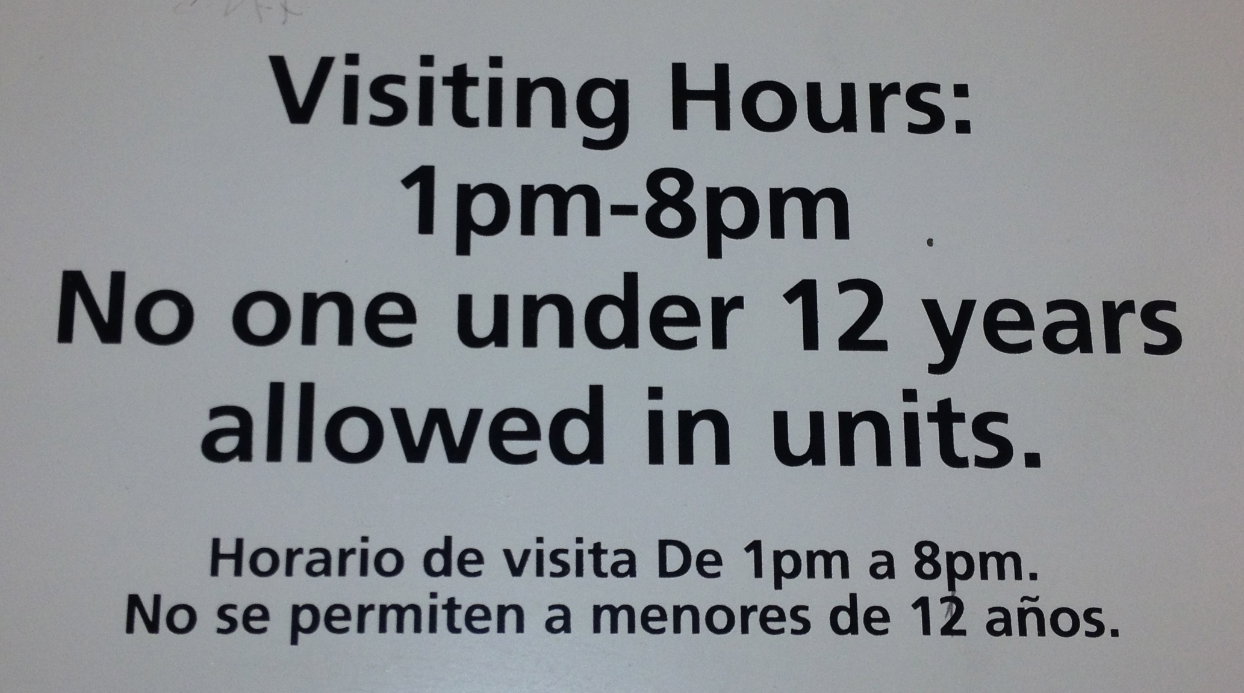
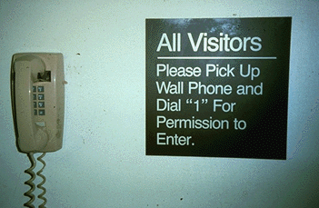
Consider the Messages These
First Impressions Convey . . .
Notes:
NOTE: If you wish, you can substitute slides from your hospital. Or add a slide following this one with signs from your organization.
These signs are not from our hospital, but we have signs like these. They convey powerful first impressions to patients and families…they label families as “visitors” which is inconsistent with the role of partnership… Our hospital needs families to be partners in the care of patients, according to the patient’s preference. Welcoming families as respected partners can be a smart patient safety strategy and a smart business strategy.

Slide 6
The Historical Perspective
Notes:
Now I would like to briefly give you an historical perspective from the health care literature.

Slide 7
Twenty Years Ago
Review of research reveals that less restrictive, more individualized visiting promotes better patient rest.
Linda A. Lewandowski, RN, PhD, Nursing Grand Rounds, Johns Hopkins Hospital, in Journal of Cardiovascular Nursing, 1994.
Notes:
Twenty years ago, a highly respected nurse researcher presented a review of the literature at Nursing Grand Rounds at a distinguished academic medical center. This presentation was later published in the Journal of Cardiovascular Nursing. A powerful story is included in the article of an elderly woman dying alone, because ICU policies were rigid and used a narrow definition of family. We can do better!

Slide 8
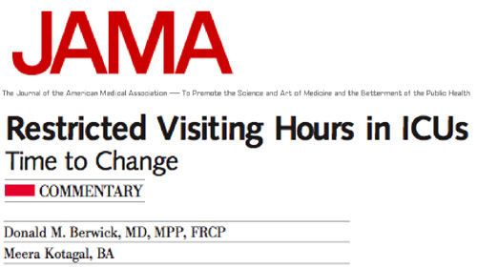
Ten Years Ago . . .
Notes:
Ten years ago, Don Berwick and Meera Kotagal spoke out in an article published in JAMA, saying that it was time to change restrictive visiting policies. Remember there is no evidence that restrictive visiting hours are the right thing to do.

Slide 9
Transforming Healthcare:
A Safety Imperative
5 Years Ago
“Organizations publicly and consistently affirm the centrality of patient- and family-centered care. They seek out patients, listen to them, hear their stories, are open and honest with them, and take action with them.”
The family is respected as part of the care team—never visitors—in every area of the hospital, including the emergency department and the intensive care unit.
Leape, L., Berwick, D., Clancy, C., & Conway, J., et al. (2009). Transforming healthcare: A safety imperative. BMJ’s Quality and Safety in Health Care. Available at: http://qshc.bmj.com/content/18/6/424.full
Notes:
National and international leaders for patient safety have spoken out clearly and consistently about the need to respect families as part of the care team, not visitors. They have also articulated the need for senior leaders to affirm the centrality of patient- and family-centered care and partnering with patients and families. This BMJ article is just one example.

Slide 10
2011
Expected Practice
  Facilitate unrestricted access of hospitalized patients to a chosen support person…
  Respecting patient preferences. . .
  Policies prohibit discrimination. . .
  Policies guide the handling of situations that interfere with safety, the rights of others, or are medically or therapeutically contraindicated . . .
Notes:
The American Association of Critical-Care Nurses (ACCN), the professional organization for critical care nurses, has long been an advocate for facilitating a hospitalized patient’s unrestrictive access to a chosen support person.
It is important to understand that having a welcoming family presence policy does not mean there are no boundaries for families. The difference is that staff can be welcoming, encouraging, and supportive for the majority of families and care partners, and manage appropriately the very small number of situations that may be disruptive or unsafe.
It should be noted that patient preferences are respected if the patient does NOT want someone with them.

Slide 11
http://www.nypirg.org/patientandfamily/pubs/20120807/Sick-Scared-Separated%20from%20Loved%20Ones%208-2012.pdf
2012
“A surprising 22% provide no visiting hours in the morning and fail to disclose any potential for flexibility, even for a patient’s support person.”
“26% of the hospital websites make public statements contrary to New York State and federal policy. . .”
Notes:
This statewide study in New York revealed appalling results about how restrictive hospital visiting policies are after more than 20 years of research findings suggesting change in policy and practice. Fortunately a 2013 follow-up study shows some improvement, but much change and improvement is still needed.
The 2013 report, SICK, SCARED and SEPARATED from LOVED ONES II: PROGRESS AND PROBLEMS IN HOSPITALS DISCLOSING THE PATIENT'S RIGHT TO CHOOSE WHO CAN VISIT, can be downloaded at http://www.nypirg.org/health/sick_scared_separated/Sick-Scared-Separated2FullRptRev08-02-2013b.pdf.

Slide 12
American Society of Healthcare Risk Management
2014
“Families of patients are not just visitors, they are a vital part of the team caring for the patient. ASHRM believes that changing the concept of families as “visitors” to one of partnership is a proactive approach to risk management.”
Jacque L. Mitchell, ASHRM President
Notes:
The American Society of Healthcare Risk Management (ASHRM) views welcoming families as partners, not as “visitors,” as a proactive approach to risk management.
As leaders of quality and safety and as the stewards of our organization’s resources, we cannot ignore this issue.

Slide 13
2014 . . .
There is growing understanding that a patient- and family-centered approach to care and authentic patient and family engagement are essential to achieving the Triple Aim.
Notes:
With many of the efforts today to redesign health care, patient- and family-centered care and patient and family engagement are fundamental. They are linked with achieving the Triple Aim.

Slide 14
Triple Aim
Patient- and Family-Centered Care
Health of Populations
Patient
Experience
Reducing Costs
"The most direct route to the Triple Aim is via patient- and family-centered care in its fullest form.”
Don Berwick
Washington DC — June 5, 2012
Notes:
Hospitals across the United States and Canada are working towards the Triple Aim… Improving the patient experience, reducing costs, and improving the health of populations. Don Berwick has stated that “the most direct route to the Triple Aim is via patient- and family-centered care in its fullest form.”
Restrictive visiting policies impact negatively on patient experience. They set barriers with the communities we serve. And they can result in unnecessary costs.
Patient- and family-centered care and the related partnerships with patients and families provide a framework and strategies to enhance quality, safety, and the experience of care.

Slide 15
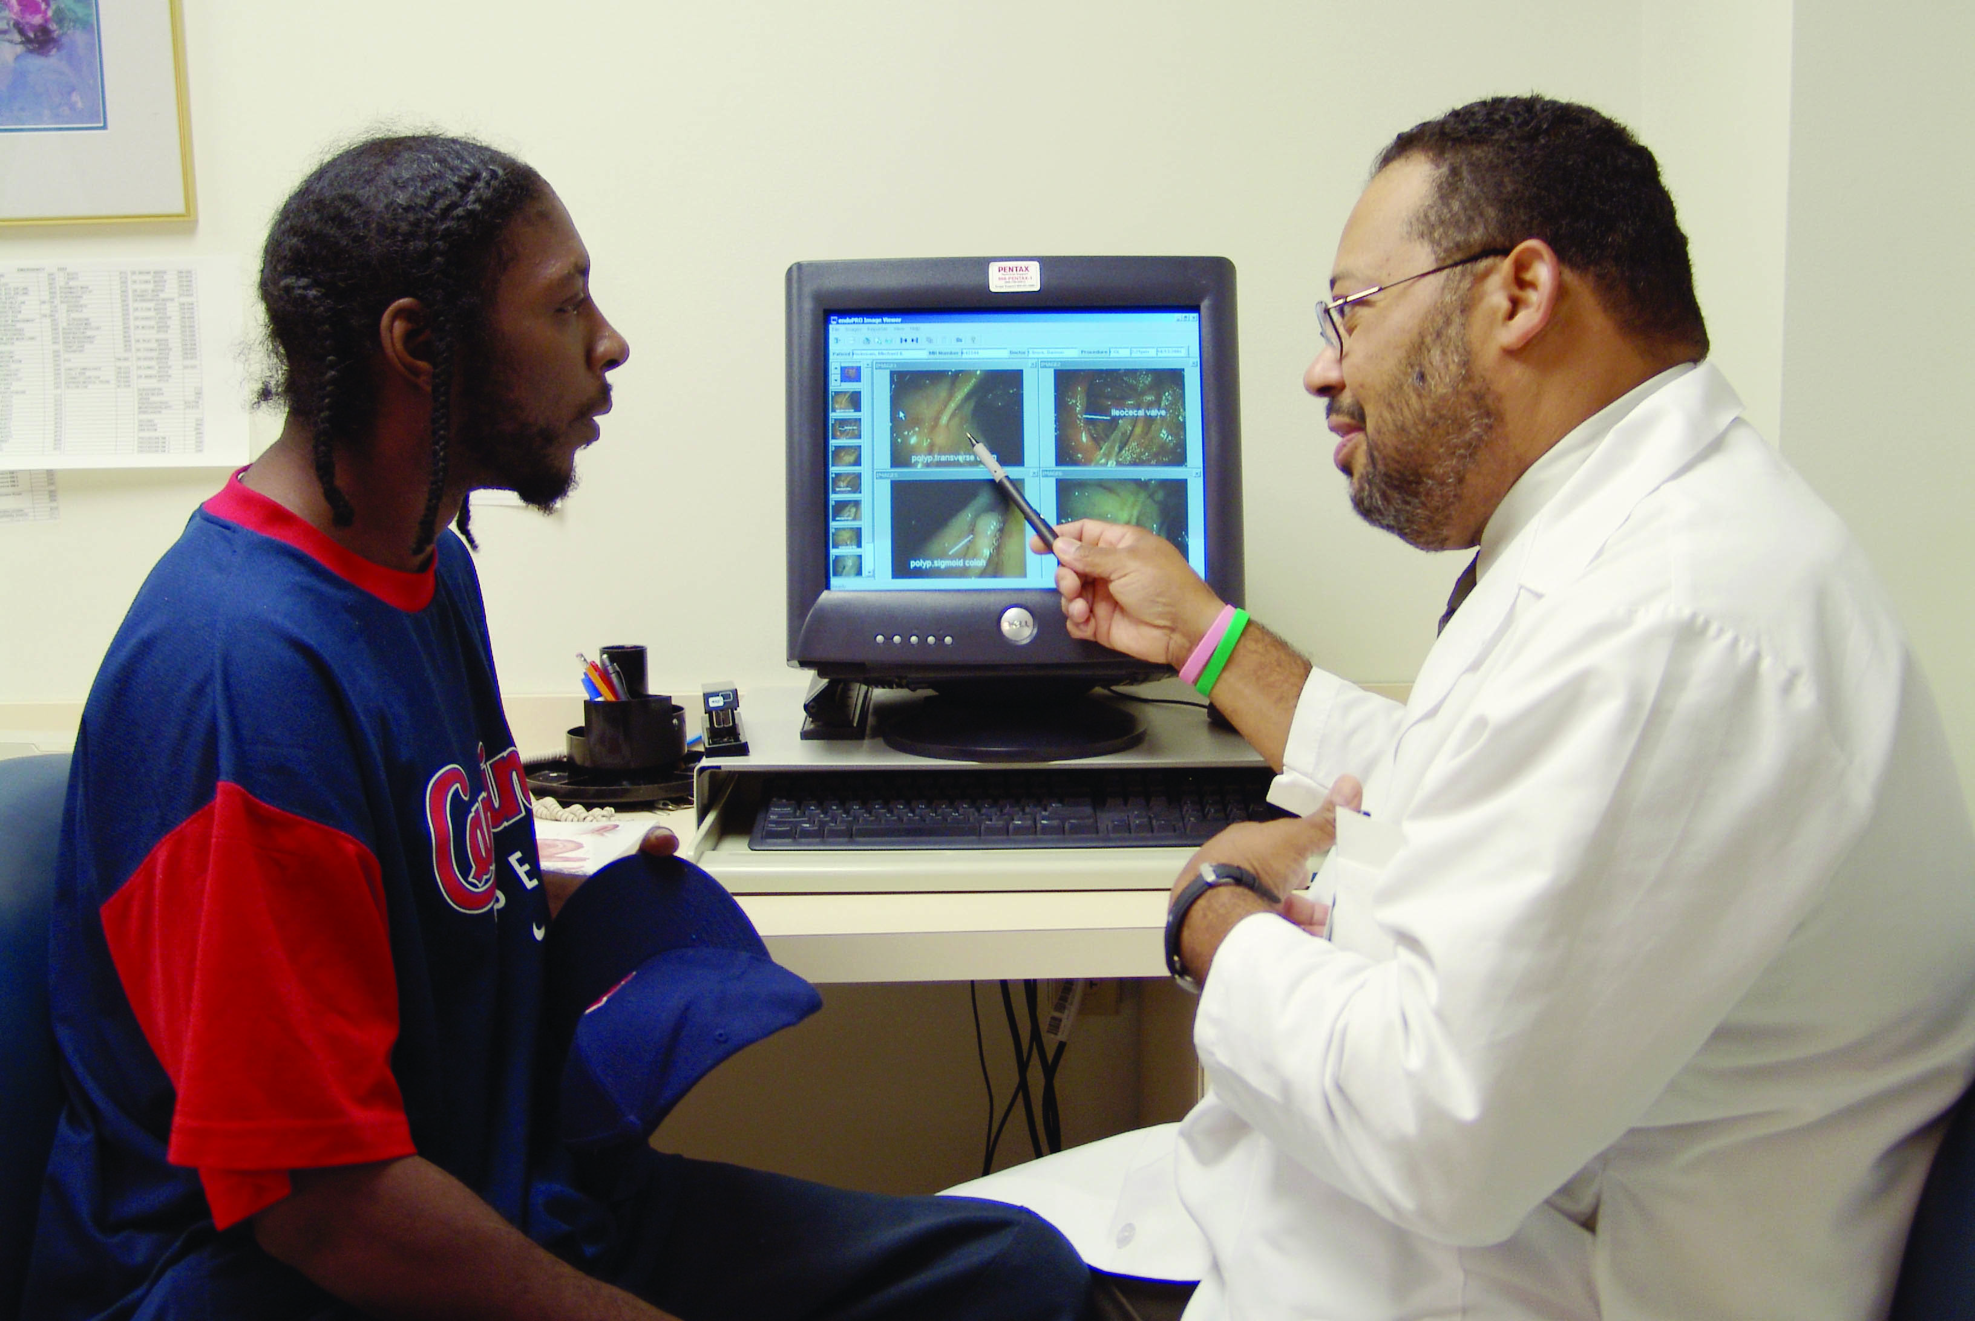

Patient- and family-centered care is working with patients and families, rather than just doing to or for them.
We cannot work with families if they are locked out of our clinical units.
Notes:
Highlight the key points on the slide…
Patient- and family-centered care is working with patients and families rather than just doing to and for them.
The little word “with” is significant in describing the way we should work with patients and families.
Another way to define patient- and family-centered care is as an approach to the planning, implementation, and evaluation of health care grounded in mutually beneficial partnerships. The core concepts are:
People are treated with respect and dignity.
Health care providers communicate and share complete and unbiased information with patients and families in ways that are affirming and useful.
Patients and families are encouraged and supported in participating in care and decision-making at the level they choose.
Collaboration among patients, families, and providers occurs in policy and program development and professional education, as well as in the delivery of care.

Slide 16
A recent (2014) report from the NPSF Lucian Leape Institute at the National Patient Safety Foundation affirms that “patients and families can play a critical role in preventing medical errors and reducing harm.”
Notes:
In 2014, the NPSF Lucian Leape Institute published a report focusing on partnering with patients and families as a critically important safety strategy. This report is consistent with changing the concept of families as “visitors” and implementing a welcoming family presence policy.

Slide 17
The Evidence to Guide Practice
Notes:
I would like to share a brief overview of the evidence that should guide our practice.

Slide 18
Evidence to Guide Practice. . .
Social Isolation is a risk factor . . .
Research is clear that isolating patients at their most vulnerable times from the people who know them best places them at risk for medical error, emotional harm, inconsistencies in care, and costly unnecessary care (Cacioppo & Hawkley, 2003; Clark, 2003).
Notes:
Highlight the information on the slide. . .
Perhaps some of you have had an experience where you, a member of your family, or a good friend were isolated in the hospital, and hospital policy prevented a family member or a loved one from being with you. Many people have these memories; the feelings of these vulnerabilities and related fear are long lasting. They often shape people’s impressions of the health system for a very long time.

Slide 19

Evidence to Guide Practice. . .
Research indicates that for many older patients, hospitalization for acute or critical illness is associated with reduced cognitive function (Ehlenbach, 2010).
Families and other care partners are much more keenly aware of any change in cognitive function than hospital staff and therefore are a valuable resource during hospitalization.
Notes:
Increasingly older people represent a significant percentage of hospitalized patients. These patients are at risk for delirium. Families can play an important role in preventing delirium, helping the patient to stay oriented to time and place.
In addition, families are often keenly aware of subtle changes in behavior, speech, and alertness. Supporting families as care partners for older people is in many ways, a safety strategy. They can help staff during hospital stays and in planning transitions to home and community care.

Slide 20
Evidence to Guide Practice . . .
For patients, evidence suggests that supporting family presence and participation according to patient preference:
  Decreases anxiety and confusion and agitation.
  Reduces cardiovascular complications.
  Makes the patient feel more secure.
  Increases patient satisfaction.
  Increases quality and safety.
Notes:
Highlight some of these findings.
Evidence clearly shows that patients benefit when they are supported in having access to their family or care partner.
If you want further information, the following references may be of interest. A comprehensive bibliography is posted on the Better Together: Partnering with Families website www.ipfcc.org/bettertogether/
Decreases anxiety (Berwick & Kotagal, Fumagalli et al., and Ramey) and confusion and agitation (Hupcey);
Reduces cardiovascular complications (Fumagalli et al.);
Makes the patient feel more secure (Gonzalez et al.);
Increases patient satisfaction (Lee et al., Fumagalli et al., Prins, Gonzalez et al., Hardin et al., Kleinpell); and
Increases quality and safety (Fumagalli et al., Adams et al., Klemen et al, Simpson and Shaver, Kraphol, Leape et al., and McAdam, Arai, and Puntillo).

Slide 21
Evidence to Guide Practice . . .
For family members, evidence suggests that unrestricted visitation:
  Increases family satisfaction.
  Decreases family member anxiety.
  Promotes better communication.
  Contributes to better understanding of the patient.
  Allows for more opportunities for patient/family teaching as the family becomes more involved in care.
Notes:
Highlight some of these findings.
Evidence clearly show that supporting family presence and participation has positive benefits for family members
If you want further information , the following references may be of interest. A comprehensive bibliography is posted on the Better Together: Partnering with Families website www.ipfcc.org/bettertogether/
Increases family satisfaction (Simon et al.; Berwick & Kotagal; Roland, Russell, Richards, and Sullivan; Fumagalli et al.; Prins; McAdam, Arai, and Puntillo; Whitcomb, Roy, & Schmied Blackman; Garrouste-Orgeas, Philippart, & Timsit)
Decreases family member anxiety (Simon et al.; Berwick & Kotagal; Prins; McAdam, Arai, & Puntillo; Marco; Simpson)
Promotes better communication (Roland, Russell, Richards, and Sullivan; Lee et al.; Berwick & Kotagal; Adams et al; Prins; 41);
Contributes to better understanding of the patient (Roland, Russell, Richards, and Sullivan; Gonzalez et al., McAdam, Arai, & Puntillo);
Allows for more opportunities for patient/family teaching as the family becomes more involved in care (Roland, Russell, Richards, and Sullivan); and
Is not associated with longer family visits (McAdam, Arai, & Puntillo).

Slide 22
Exemplar Hospitals
Many leading hospitals already recognize that partnering with patients and families is a smart business strategy.
Notes:
Profiles of exemplar hospitals can be found on the Better Together: Partnering with Families website: www.ipfcc.org/bettertogether/
IPFCC has also published a book that may be of interest:
Partnering with Patients, Residents, and Families—A Resource for Leaders of Hospitals, Ambulatory Care Settings, and Long-Term Care Communities

Slide 23
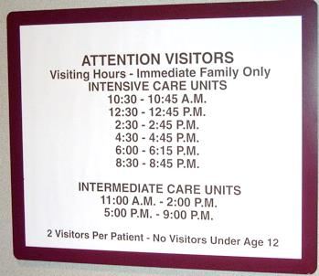

Vidant Health: Changing the Concept of Families as Visitors
The message of partnership is now a first impression for cardiac patients and their families.
Notes:
Vidant Health, a winner of the prestigious 2013 John Eisenberg Patient Safety Award, changed the concept of families as “visitors” and now encourages and supports partnerships with patients and families at all levels of care.
The signs on the left are the old restrictive visiting hours that have been replaced with the simple, positive message of “Welcome to 2 North.” The brochure on the right conveys the message of partnership early in the experience of care for patients and families at the Heart Institute.
A profile on Vidant Health can be found on the Better Together: Partnering with Families website: www.ipfcc.org/bettertogether/

Slide 24
Vidant Health, Greenville, NC
A Key Strategy for Quality and Safety
Dramatic improvement in the UHC Scorecard composite for patient-centeredness: 16th in 2009, 3rd in 2010, and 2nd in 2011 and 2013.
System-wide HCAHPS patient experience at 91st percentile.
109 Serious Safety Events in 2007, 22 in 2012
20 Patient and Family Advisors in 2007, 145
in 2012
Notes:
Highlight the data that is shown on the slide…
The process for changing visiting policies began in 2008. While there were other initiatives focusing on quality and safety improvement during this 4-5 year period, leaders believe that family presence and partnerships with patients and families were vital to achieving these outcomes. Leaders of this organization linked patient- and family- and centered care together in the five year Safety Plan, saying: “Quality and safety work is patient- and family-centered.”
Patient and family advisors participated actively in all phases of the process of change. There are currently over 140 patient and family advisors serving in a variety of roles on councils and committees throughout Vivant Health.

Slide 25
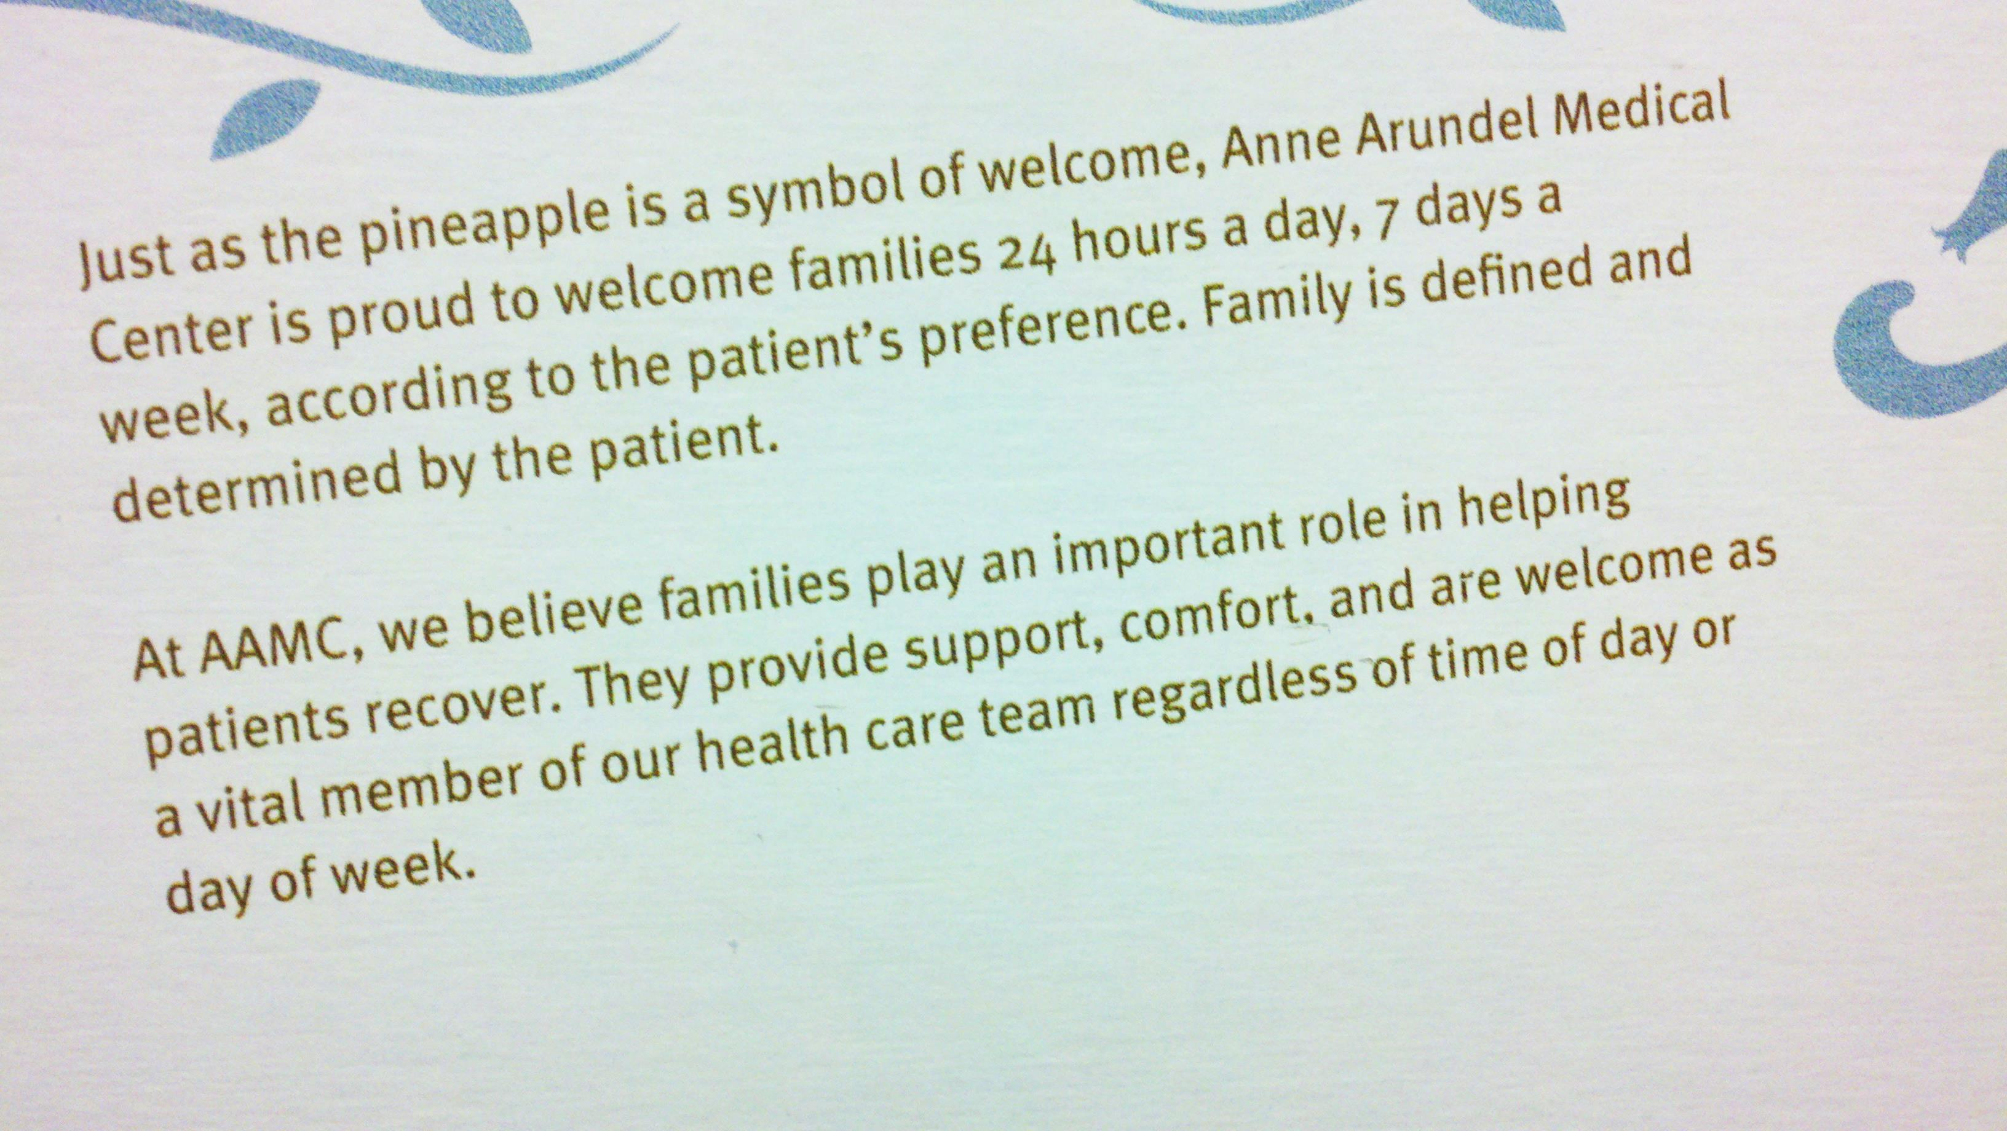
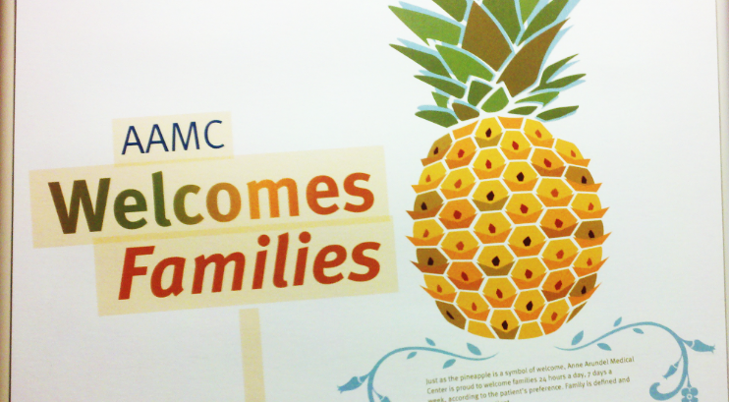
Anne Arundel Medical Center, Annapolis, MD Changing the Concept of Families as Visitors
Notes:
Anne Arundel Medical Center is 385-bed regional not-for-profit health system, headquartered in Annapolis, Maryland. In 2010, it began its journey to implement patient- and family-centered care and to partner meaningfully with patients and families in direct care and in quality improvement, safety, and program development activities.
The hospital spent a year thoughtfully preparing the organization to change the “visitation” policy to guidelines where families are welcome 24/7 according to patient preference. This dramatic change in organizational culture was a strategic goal for the health system in 2010-2011.
In 2009, there were no patient and family advisors volunteering at the hospital. In 2014, there are approximately 80 advisors. Patient and family advisors were involved in changing the concept of families as visitors, implementing bedside change of shift report, developing a collaborative discharge/transition planning processes, and developing the process for geographically assigning hospitalists to specific units.
A profile on Anne Arundel Medical Center can be found on the Better Together: Partnering with Families website: www.ipfcc.org/bettertogether/

Slide 26
Anne Arundel Medical Center Annapolis, MD
Since 2009, the overall rating of the hospital has gone from 75.4% to 82% (the national average
is 70%).
The hospital regularly has the highest HCAHPS patient experience scores in the state of Maryland.
The hospital was recognized as one of top ten surgical hospitals in the country in the August 2013 issue of Consumer Reports, and it was recognized as the best hospital in the region by Washingtonian Magazine in 2014.
Notes:
Discuss the data on the slide.
In the last five years, the trend line for their data has been positive, resulting in 7.4 % increase in the overall rating of the hospital.
Leaders believe that the commitment to patient- and family-centered care and authentic partnerships with patients and families in major planning and decision-making for the hospital have been significant contributing factors to their success.
In 2012, patient and family advisors began to participate as members of the Medical Staff Peer Review Committee, and in 2013, as members of the Quality Committee of the Board.

Slide 27

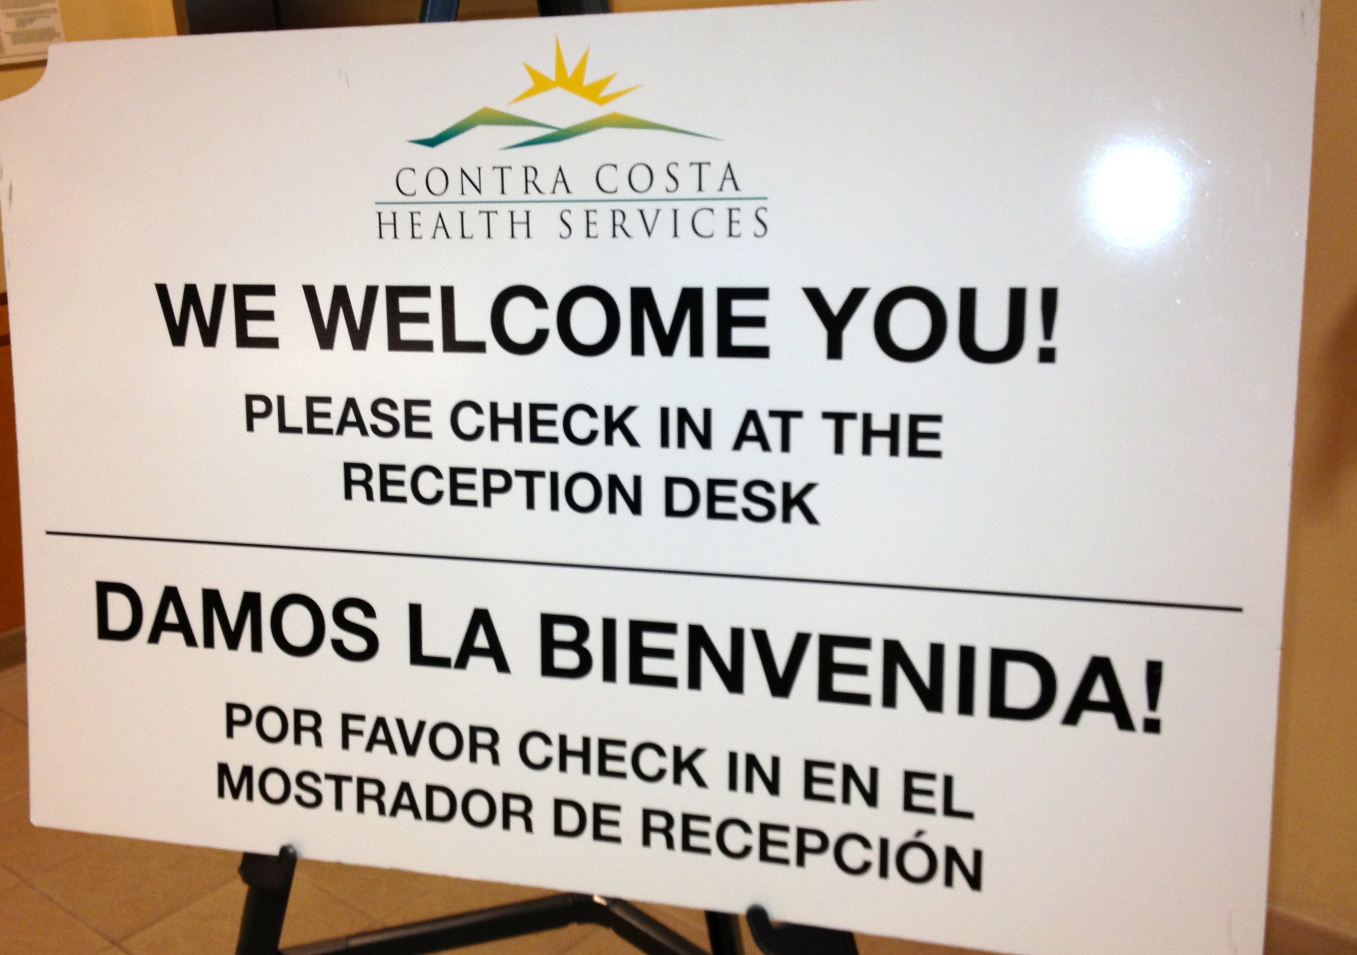
Contra Costa Regional Medical Center, Martinez, CA
Implementing a new philosophy of welcoming families . . . With a commitment to learning and quality improvement as integral to the process.
Notes:
Contra Costa Regional Medical Center is a 166-bed public hospital serving a diverse community in northern California. It is an organization very committed to quality improvement.
A compelling family story was the impetus for this hospital to “do better.” With thoughtful collaborative efforts, the executive team led a process of change. Two individuals brought the perspective of family partners. The chief of security also serves on the Executive team.
With support from frontline staff and physicians, the executive team made a decision to create a welcoming policy, very different than just “open visitation.”
Several videos about about Contra Costa Regional Medical Center Center can be found on the Better Together: Partnering with Families website: www.ipfcc.org/bettertogether/

Slide 28
Contra Costa Regional Medical Center, Martinez, CA
Since September 17, 2013 though June 15, 2014, over 5,300 families spent time with patients, during hours not previously allowed.
There have been NO security events as a result of the new Welcoming Policy.
The hospital is regularly tracking patient, family, and staff perceptions of the change in policy.
This hospital is also tracking progress and impact through an adaptation of the Better Together Metrics template (available at www.ipfcc.org/bettertogether/ ).
Notes:
The data on this slide represents the emerging data from Contra Costa Regional Medical Center. They are tracking the process on a regular basis.

Slide 29
Our Plan of Action
Notes:
I would like to conclude with our Plan of Action.

Slide 30
Our Plan of Action . . .
Use patient and family stories to illustrate the need and urgency for change.
Appoint a planning team with all key stakeholders — review current policy and practice.
Identify barriers and challenges that are preventing our hospital from changing the policy and, then, problem-solve, one-by-one.
Acknowledge and address staff concerns.
Learn as you go; engage in continuous learning. Be willing to make changes in your plan.
Evaluate progress, publish the results, and share with staff . . . Celebrate our successes.
Notes:
Discuss your plan of action. These are suggestions based on the successful process of change used by other exemplar hospitals. Tailor these bullet points in a way that works for your organization.

Slide 31
Questions and Comments
Eliminating restrictive visiting policies and supporting staff to welcome and partner with families and other care partners is a smart business decision that can help our organization improve the experience of care, reduce harm, and improve the transitions of care.
Notes:
In summary, eliminating restrictive visiting policies and supporting staff to welcome and partner with families and other care partners is a smart business decision.
It can help the organization improve the experience of care, reduce harm, and improve our care transitions.
Conclude with giving your audience a chance to ask questions and offer comments.

Slide 32
Supporting Staff for Change in Practice
Offer staff skill building opportunities for:
Welcoming a new patient or family.
Asking patients to define their “family” or other care partner and their role in care planning and decision-making.
Partnering with patients and families at the bedside.
Building on patient and family strengths.
Engaging patients and families in care planning and decision-making.
Working confidently in the presence of families.
Respecting privacy and confidentiality.
Managing difficult situations.
Engaging in reflective practice.
Notes:
You may decide to delete this slide. This level of detail may not be necessary for you audience of senior leaders, but some may be interested.
The evidence does not justify continuing to have restrictive “visiting” policies, but it is important to respectfully address each one of the concerns that staff and clinicians raise as part of implementing a welcoming family policy. if not addressed, these concerns can be barriers to implementation. Education and preparation for working in new, more collaborative ways will address many of the concerns of staff and clinicians.
Changing the concept of families as visitors is not simply changing a written policy, but it entails support for change in practice.

